Slide 1
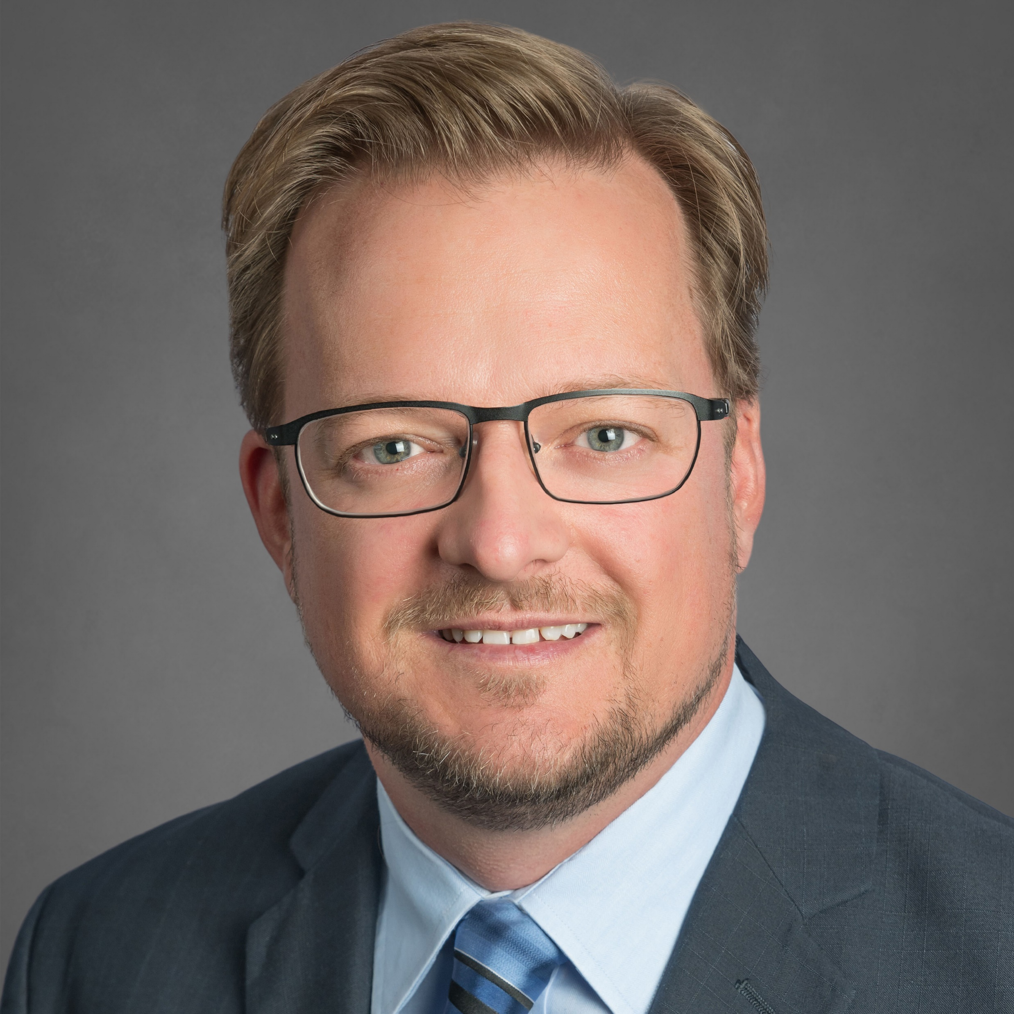
MATHIEU PRICHONNET Eng., MBA, PMP, SAFe 5. Technology | Delivery | Services | Transformation
9505 PR 6660 Lubbock TX 79416
646-584-8331
Fluent in both French & English
US Citizenship
INDUSTRY EXPERIENCE EXPERTISES
Construction: Kiewit, Lemcon Networks, MWH
Government: CSEM, SFMTA. Amtrak, FAA, NYSCA
Utilities: Duke Energy, OG&E (T&D), CENG (Nuclear)
Mining: Freeport Mc Moran
Chemical: Grace (engineering intern), DOW, Olin
Technology / Telecom / UV: Plume, DroneUp
Financial / Retirement services: One America
Healthcare: Carescout
Skillsets: Digital Transformation (SAFE 5.0), Strategy & Delivery Lead (Waterfall & Agile), Portfolio, Program & Project Management, Functional & Detail Design, Integration, Conversion, Migration and DW, Data Consolidation & Testing
Testing / QA: Jira; LoadRunner / HP ALM & UFT; IBM Rational
Platforms: Smartsheets, Jira / Confluence, Ms. Project; EPPM Primavera P6 (Client / web / Team Member0; & Unifier EcoSys; Clarity; SAP PM/PS; Maximo; InEight; Mural; Jama
Analytics: Tableau, Analytic Solver
BACKGROUND & EDUCATION
Highly innovative, strategic thinker experienced leader with over 23 years of substantial consulting and corporate experience in Delivery, OPS, Prof. Services / CS, Products & ePMOs, as well as selling / implementing medium to large strategic digital life-cycle transformation initiatives through optimization of People, Processes, Products (PPP). Simplify complex problems through analysis, investigation, presentation as well as execute to target OKRs. High degree of collaboration.
Areas of expertise:
End to end strategic road mapping (design thinking) for digital transformation leveraging technology and the 3 P’s: (1) Product / Systems, (2) People (right people / right positions), (3) Processes / Minimize Customer Data Management (analyze data)
Build ePMO to support Business Transformation (BPM & business re-engineering) / Corporate governance / Change management / create ePMOs / streamlining CAPEX & OPEX / Business Analysis / Business Case / Translate Corporate to ePMO strategies.
Engineering Program Management and Estimation. Design and Build procurement As-a-Service / Green- Brown field Commissioning Project / Digital Twin (standardized sourcing blueprints, e-Sourcing, supplier intelligence, benchmarking and estimating, market intelligence) / GIS, T&D, Nuclear / Connected worker / Project lifecycle management
Off the shelf systems & custom application (Java, C+) Design & Implementation for Cost, Estimation, Scheduling and Transactional platforms (Oracle P6, EPPM, Unifier / Hexagon EcoSys / Clarity PM / MS Project, / InEight / Timberline / SunGard Omni & Omni trade). • Data Migration, Conversion, and Integrations (Java / Informatica / Web methods) to ERP systems - SAP PM, PS / Work Order – Maximo.
Emerging technologies (AI / Neural Network, Machine Learning, Data Science / Big Data & Data Warehouse) for intelligent analytic progress reports (Microsoft Power Business Intelligence). Custom app design, document artefacts (deployment models, sequence Diagrams, Wireframing, etc.)
Product capability prioritization (both functional, technical and user experience), product vision and strategy, and plans for product delivery.
MBA (TTU – Rawls, USA, 2020)
Operations Management (HEC Montreal, CANADA, 2007)
Construction Engineering (ETS Mtl, CANADA, 1999)
SELECTED EXPERIENCES
Startups (Plume, DroneUp & Carescout 2021-present): Digital Transformation (Tech Stack), PPP (People, Processes, Products) & Portfolio management. Build and ran ePMO. Strategy and M&A
Accenture 2015-2020
Delivery & Proposal lead (Program Mgr.) for strategic Digital Transformation initiatives for various clients. Integrated mobility, web or cloud-based solutions for various platforms (SAP PM/PS, Oracle Primavera, Clarity, Hexagon EcoSys). Experience in modifying and transforming BPM platforms (Oracle Unifier, Appian). Exposure to estimation platforms (InEight, Timberline). Working with C level suite to streamline PMO & Capital Project Portfolios & Programs. Governance models, project financial planning and reporting. Integration experience between various systems (Maximo, SAP). Analytics. Proposal and Deal negotiation and execution. Lead both Onshore & Offshore teams. Sales Pipeline of $16M in 2019-20. Helped sell and contributed to team chargeability remaining >68%.
Major Chemicals 2018-2019: Lead enhancement effort at Chemical client for EcoSys (v8.3) cost management and SAP-PS/PM integration enhancements (Agile method). Developed strategic IT PMO processes and tool adoption as well as strategic planning and budgeting. Lead team of 5. Savings of ≈ $800K / yr.
Super regional Utility 2015-2017: Lead several teams (40+ resources onshore/offshore) at super-regional Utility (T&D) client for an integrated project controls implementation for the transmission division. Implementation of Oracle EPPM (v15.1.2) and EcoSys (v7.04) software + integration with Maximo, Power Plan & other internal systems >100 interfaces. (Informatica, Web methods, Java script). ROI of ≈ $8M over 5 yrs.
One America 2014-2015: Responsible for 2 main projects: (#1) OMNI (SunGard) record keeping platform upgrade (v5.8 to 6.05) and (#2) Modification of OMNI platform to process request faster for additional new Investments. Lead 2 teams of 8-15+. Savings ≈ >2K manhour/yr. Developed PMO processes and tool adoption as well as strategic planning with implementation new CA Portfolio mgmt. platform (business process & systems / platform) using CA PPM (v14.2). Portfolio & Program Analytics / Resource Demand visibility and optimized workforce assignment.
Hexagon 2007-2013: Sr. Consultant for Cost system implementation (Sun Trust, Amtrak, NYSCA, CENG, FAA)

